Slide 1
DevelopHER 2016
Proudly sponsored by MYOB

Slide 2


Slide 3
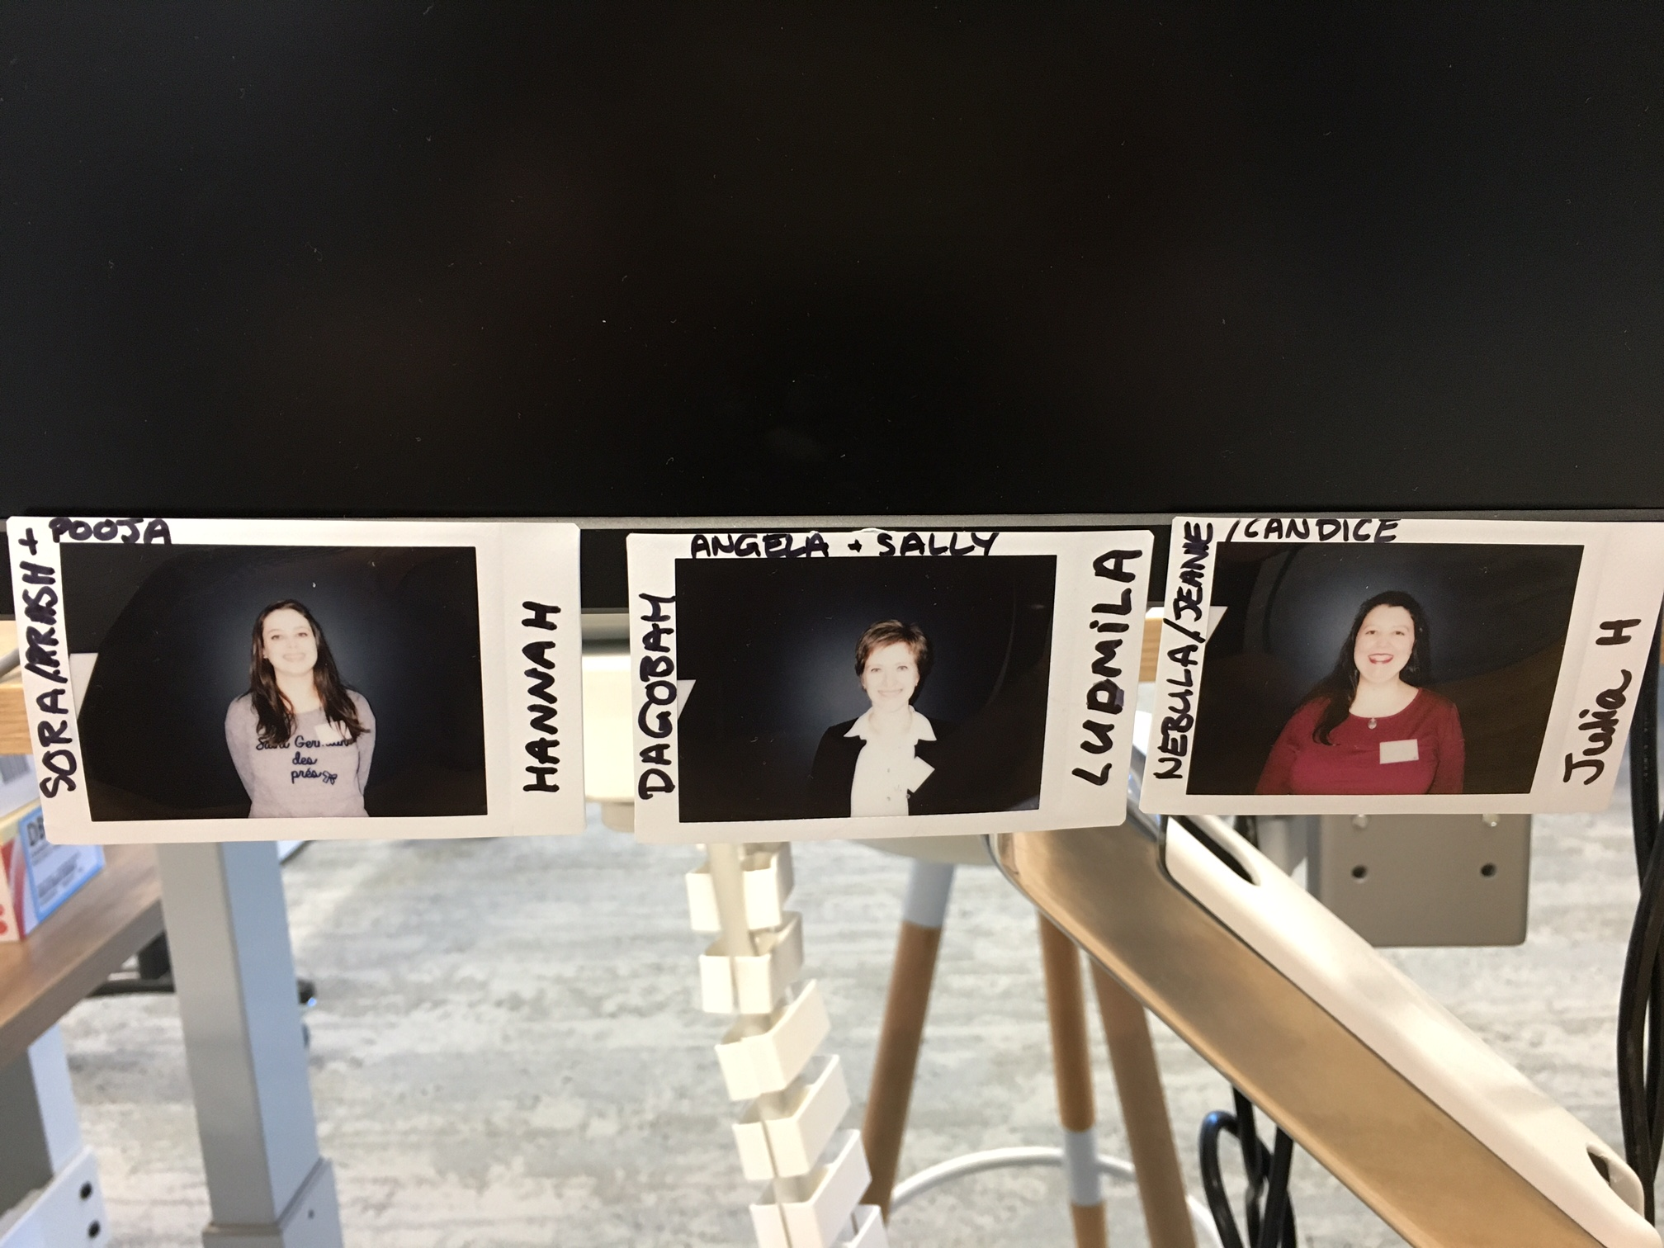
Chosen DevelopHERs
Julia
Hannah
Ludmila

Slide 4
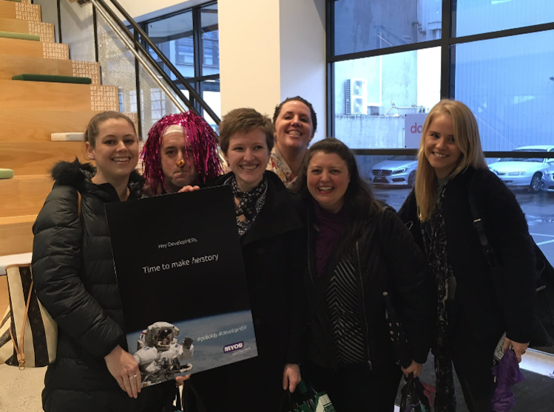
First day as DevelopHERs
It was our first day at MYOB as DevelopHER interns.
Here comes the description.

Slide 5
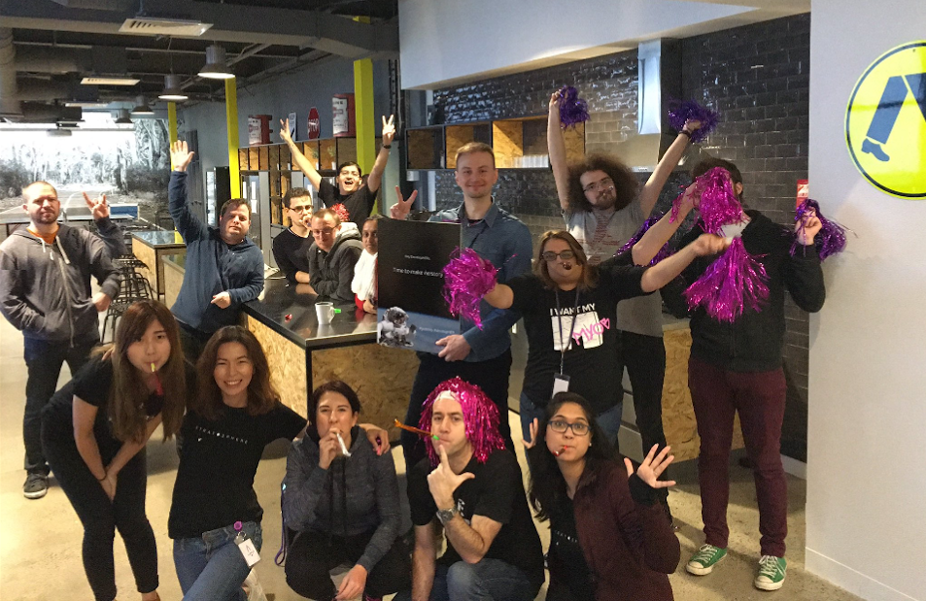
DevelopHERs welcoming celebration
Greeting/welcoming

Slide 6
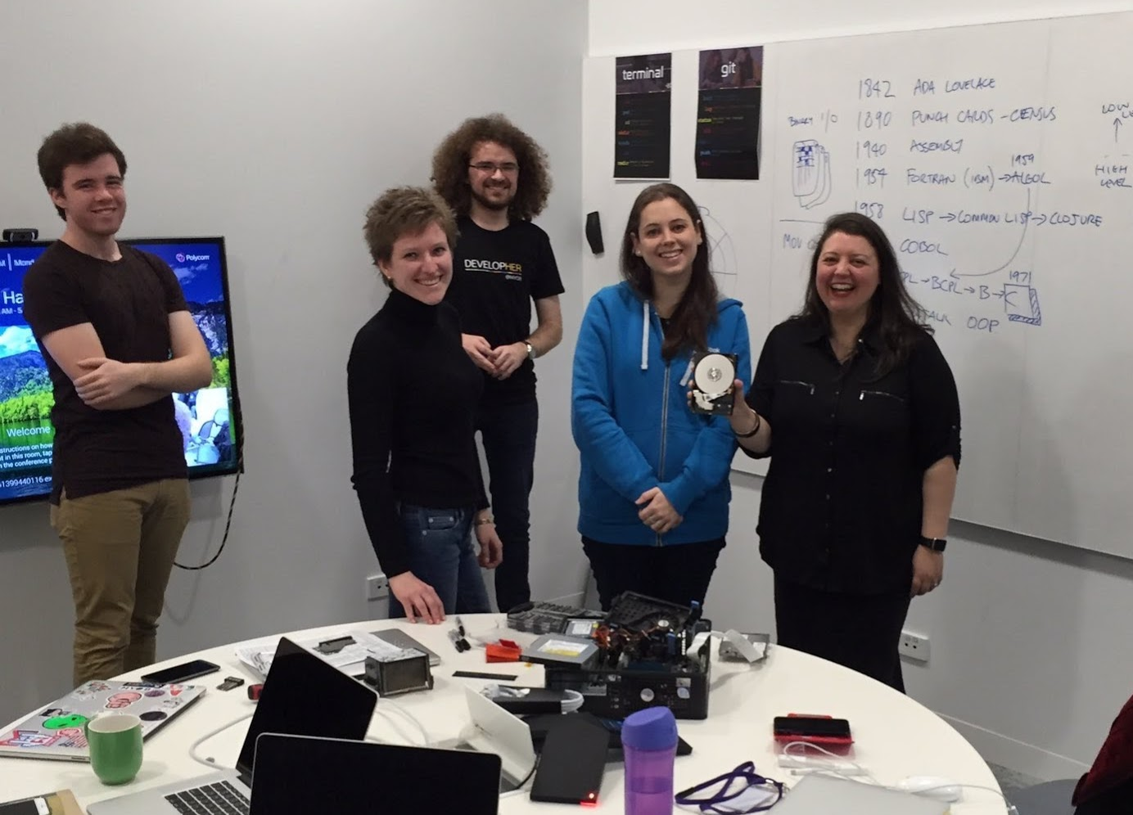
Classroom session
First day in the classroom – history of SW development

Slide 7
Learning Agile Manifesto Terminal & Git Commands

Slide 8
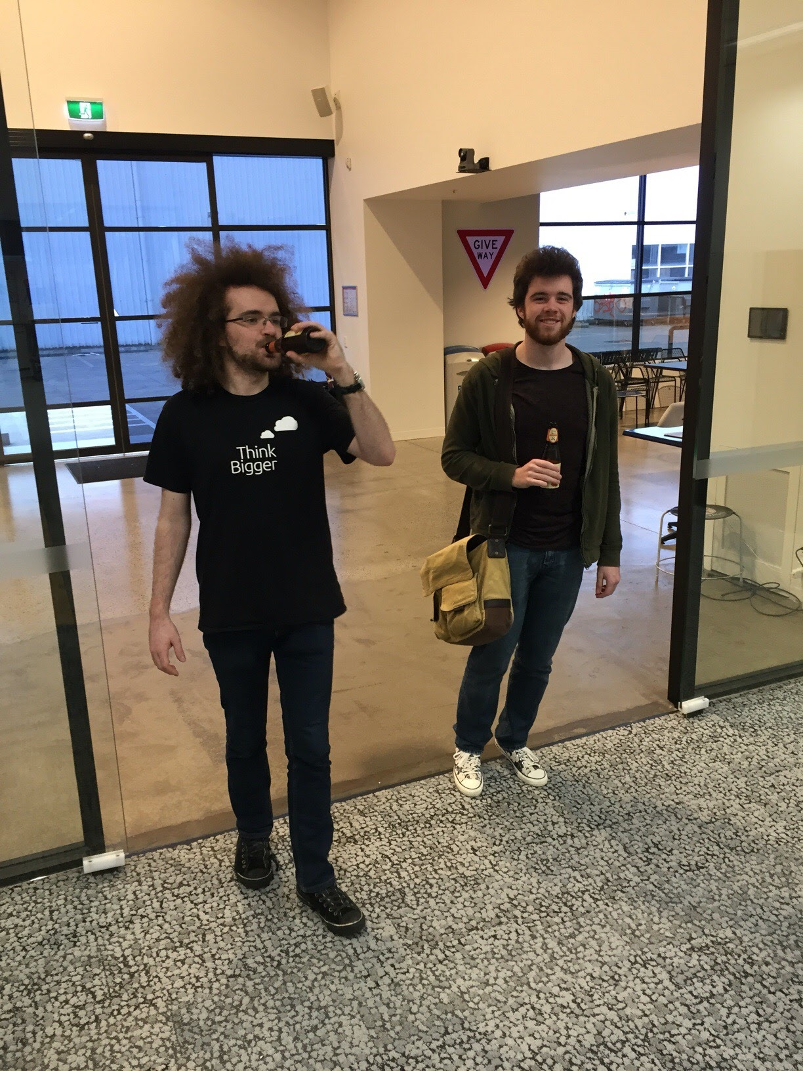
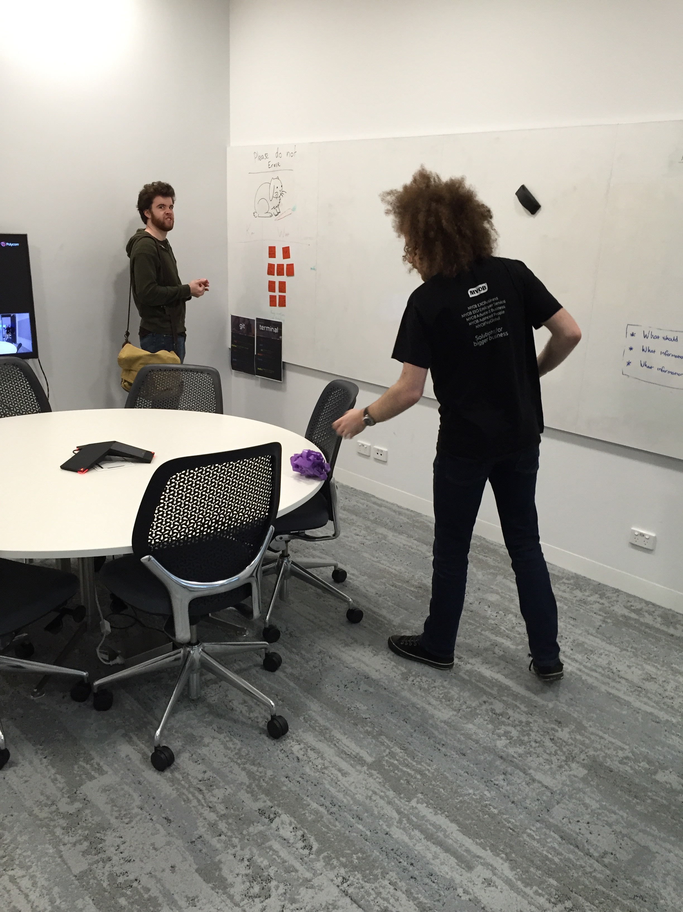
Teachers
description

Slide 9
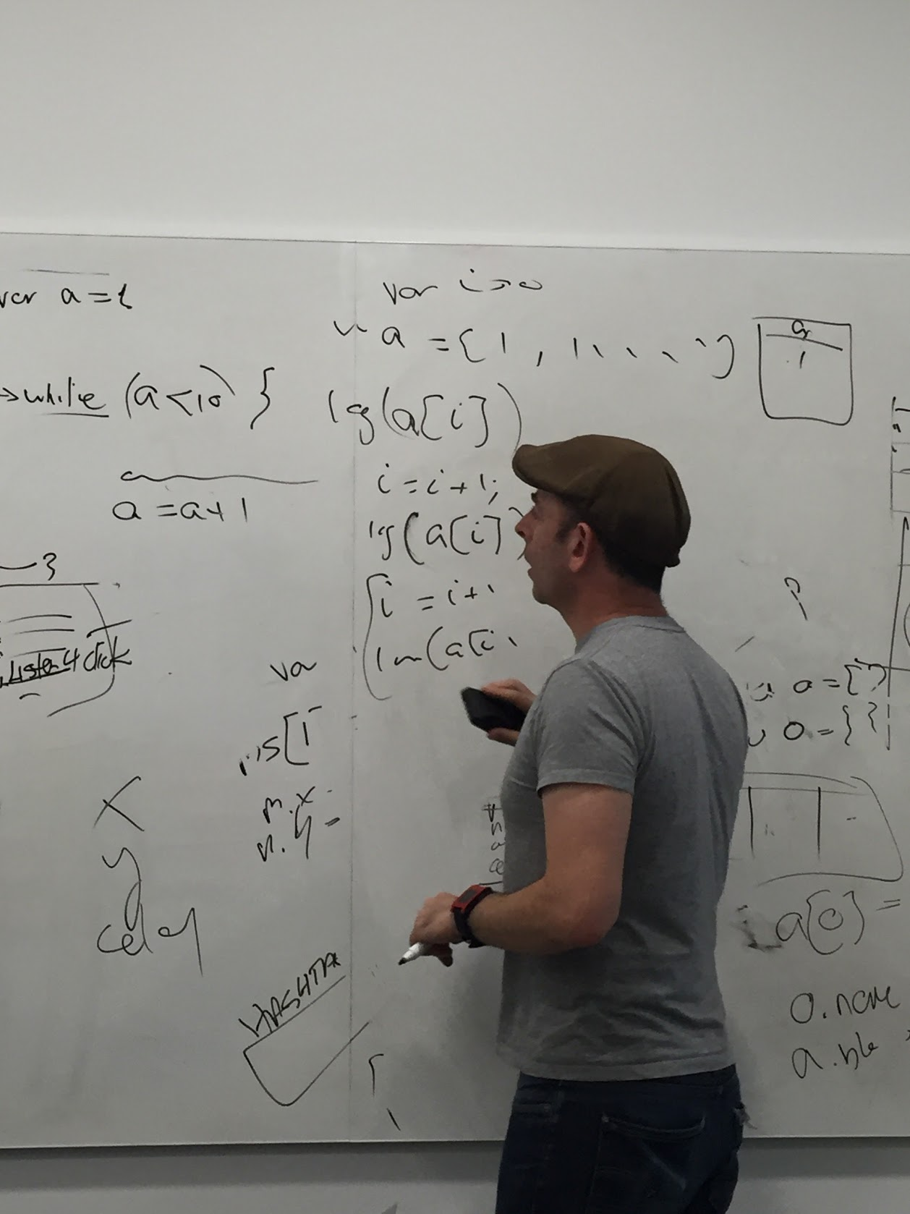
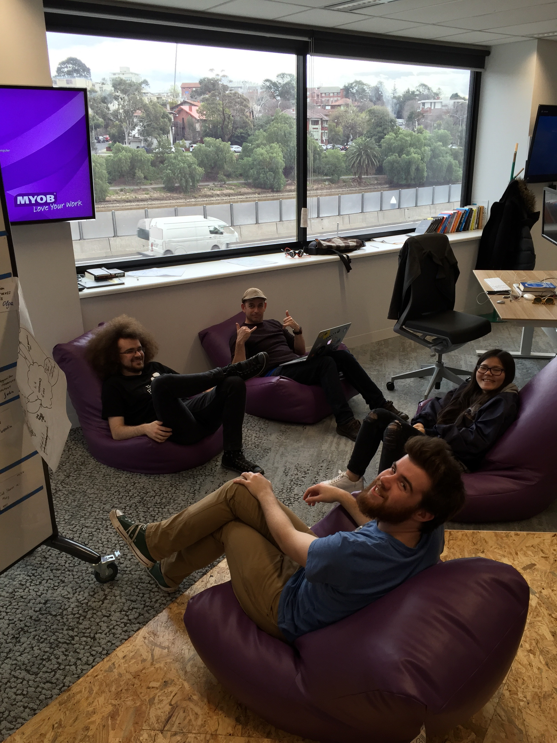
Simon the teacher
Description

Slide 10
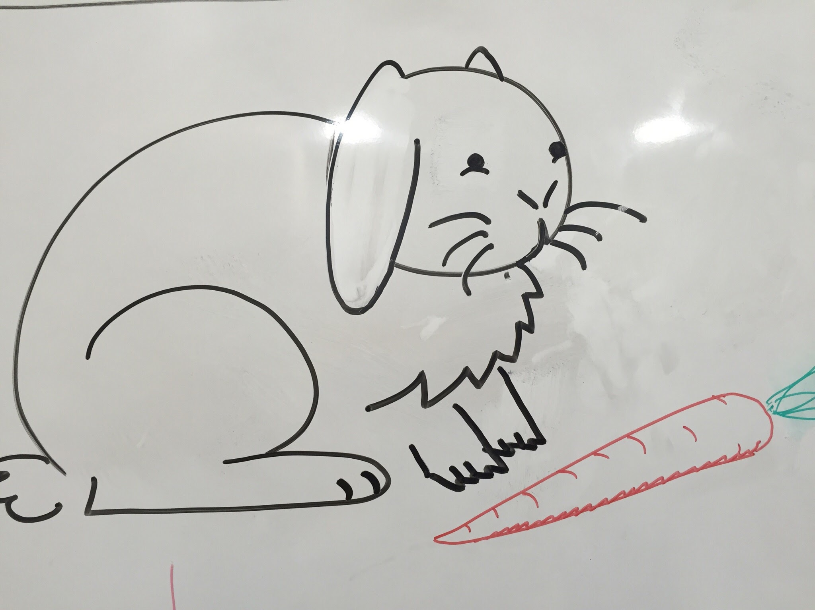
Lovely rabbit
Description

Slide 11
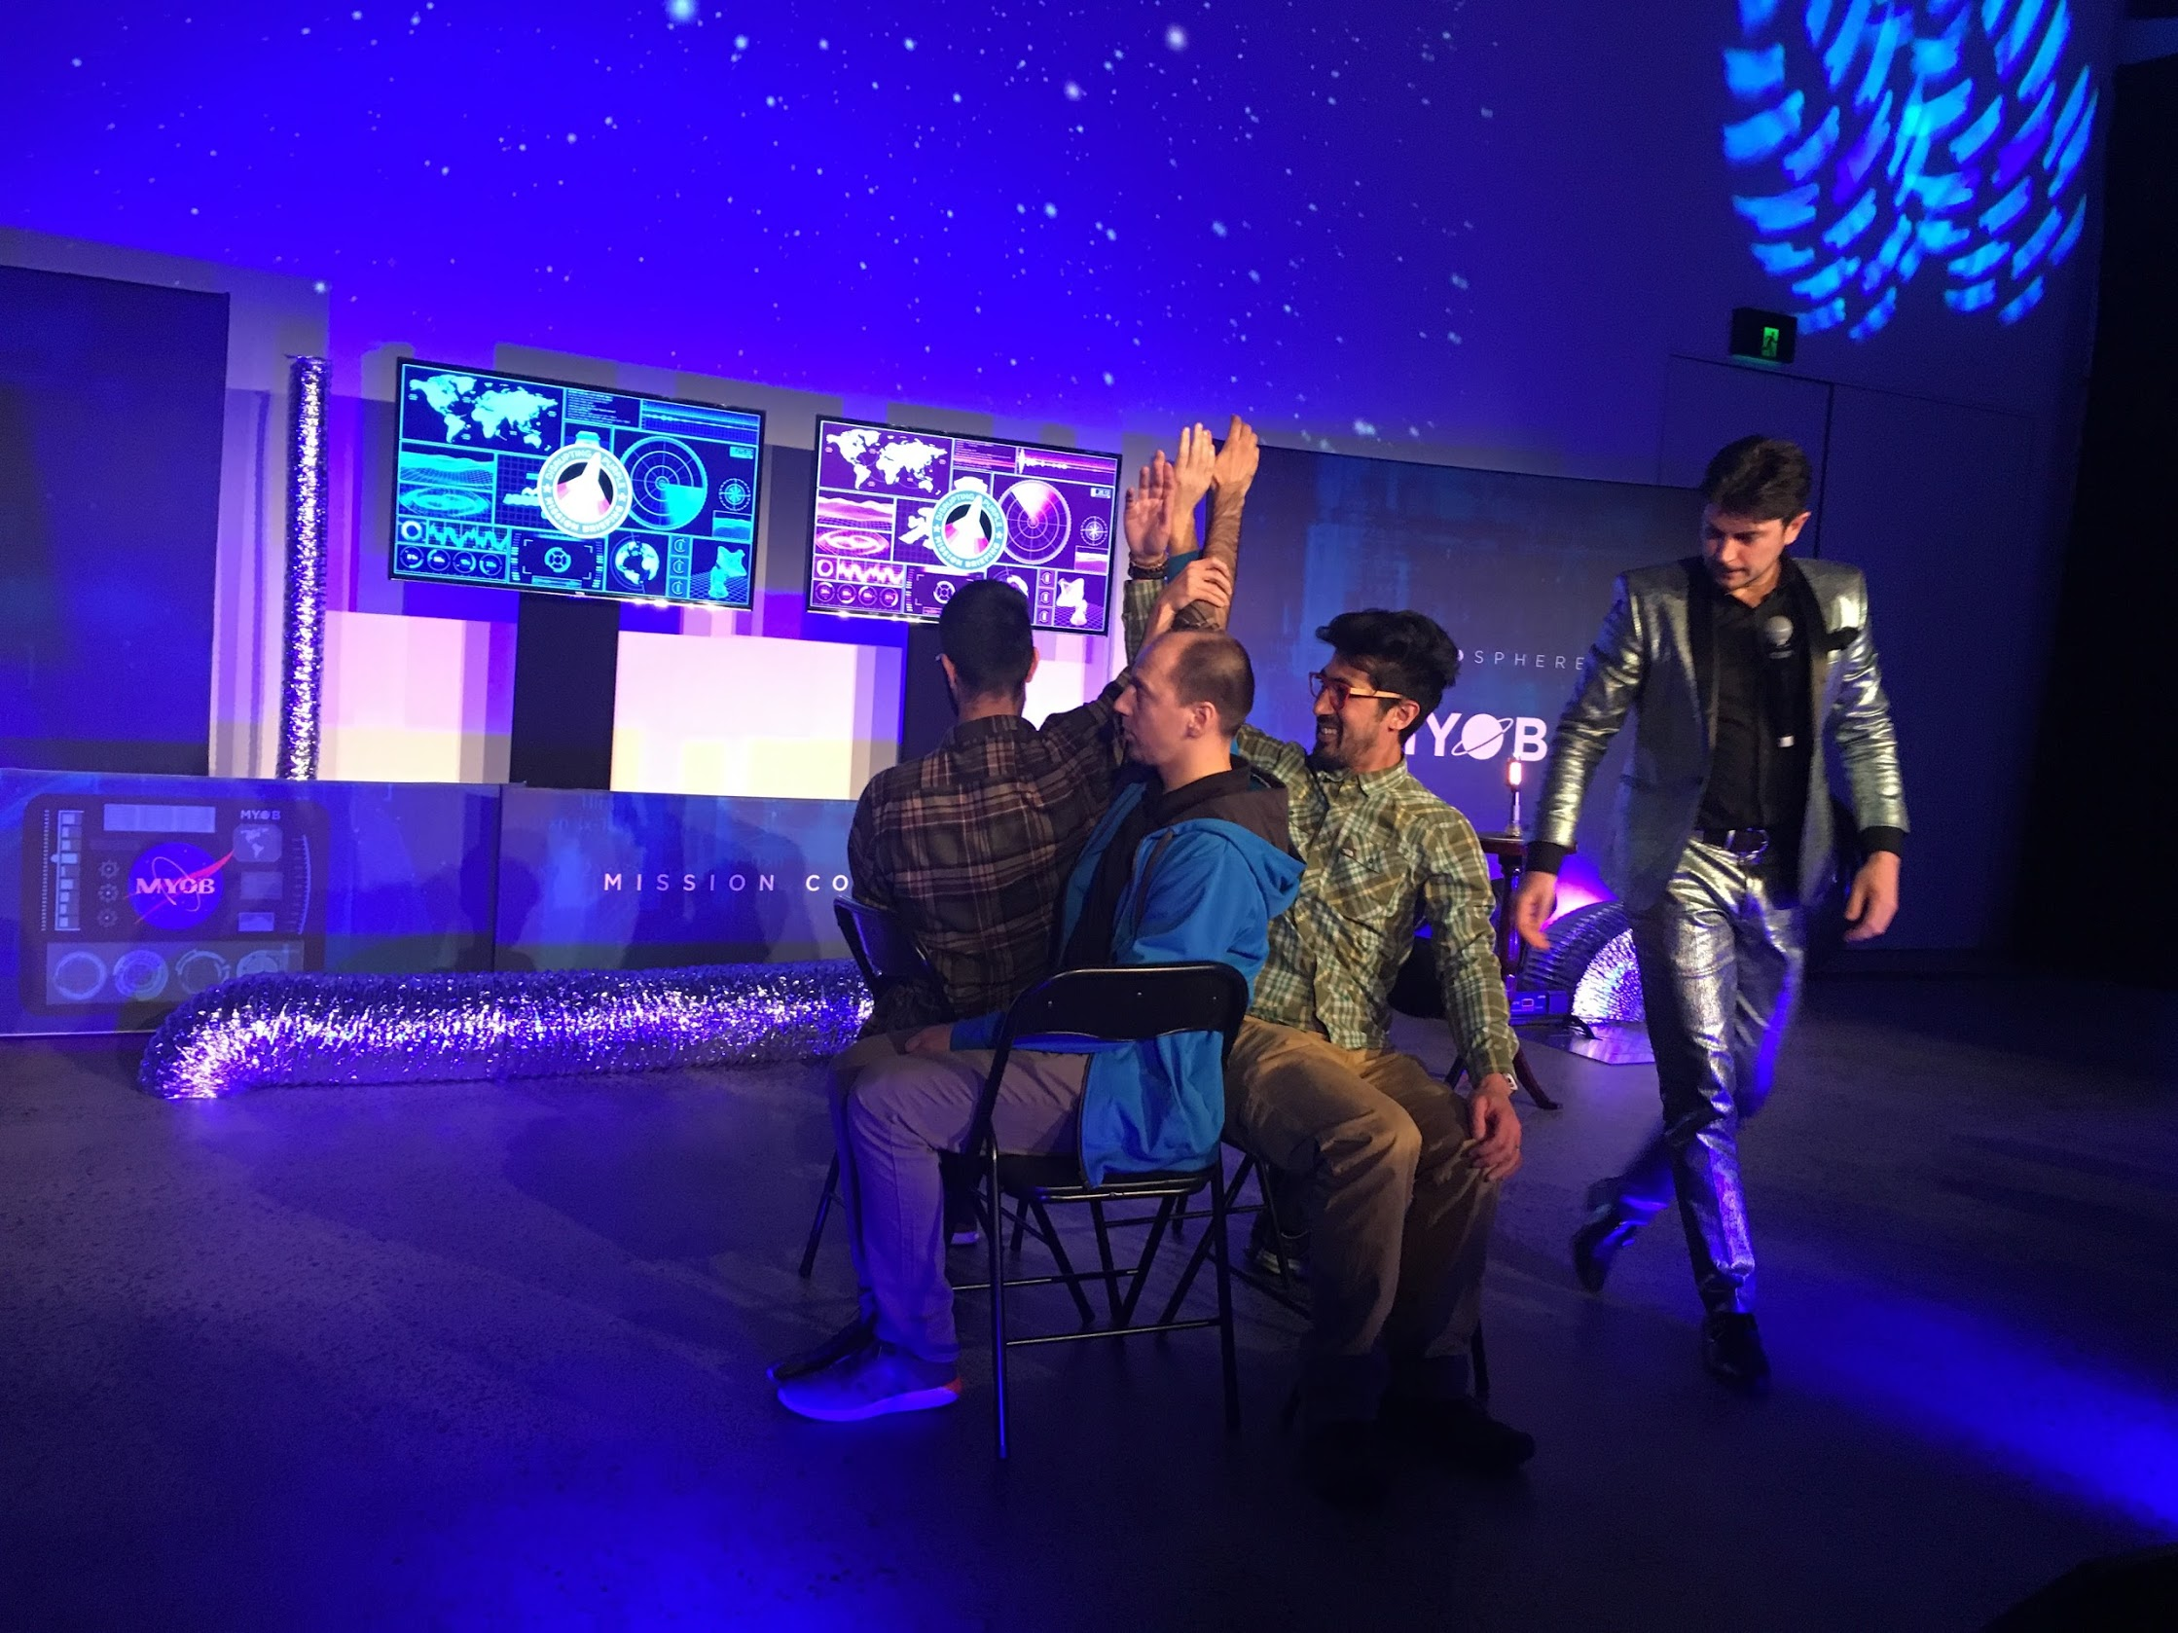
Disrupting Purple
Description

Slide 12
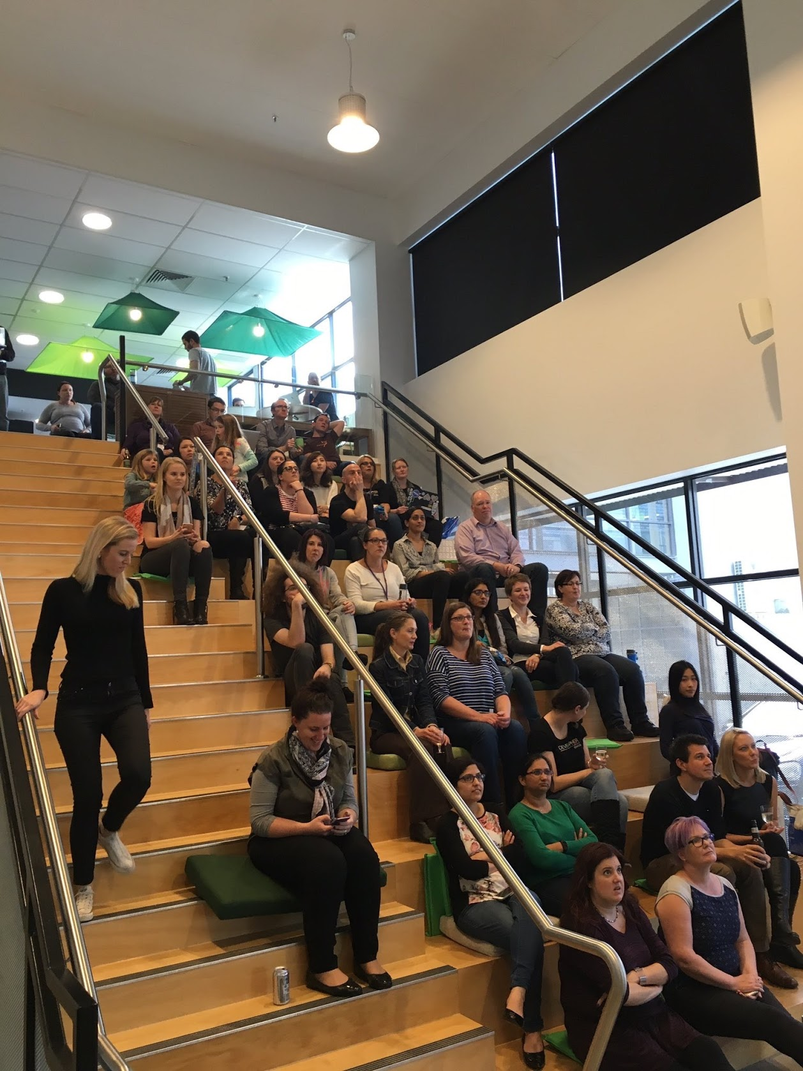
Code: Debugging The Gender Gap (A Documentary)
Description

Slide 13
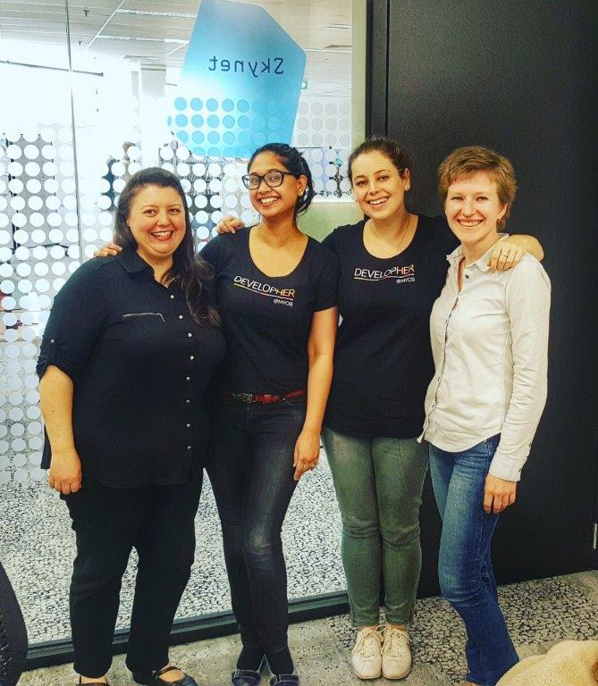
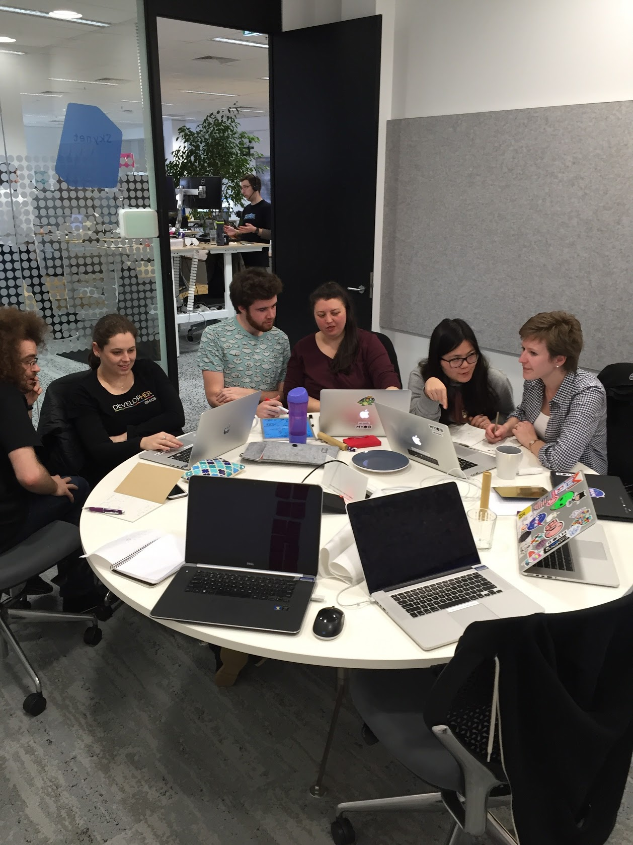
Classroom experience
Description

Slide 14
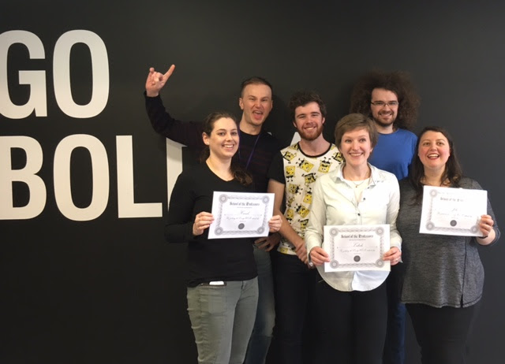
Graduation

Slide 15
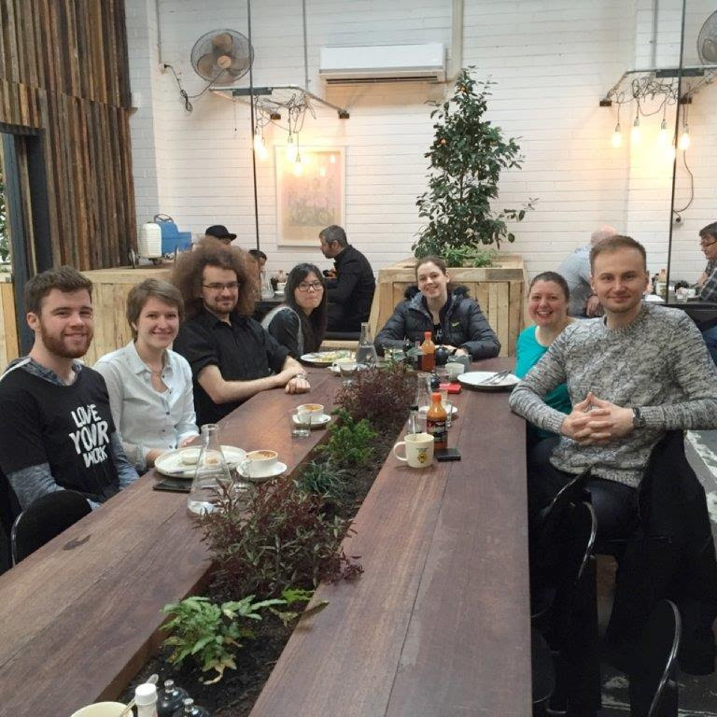
End of learning in the class
Description

Slide 16
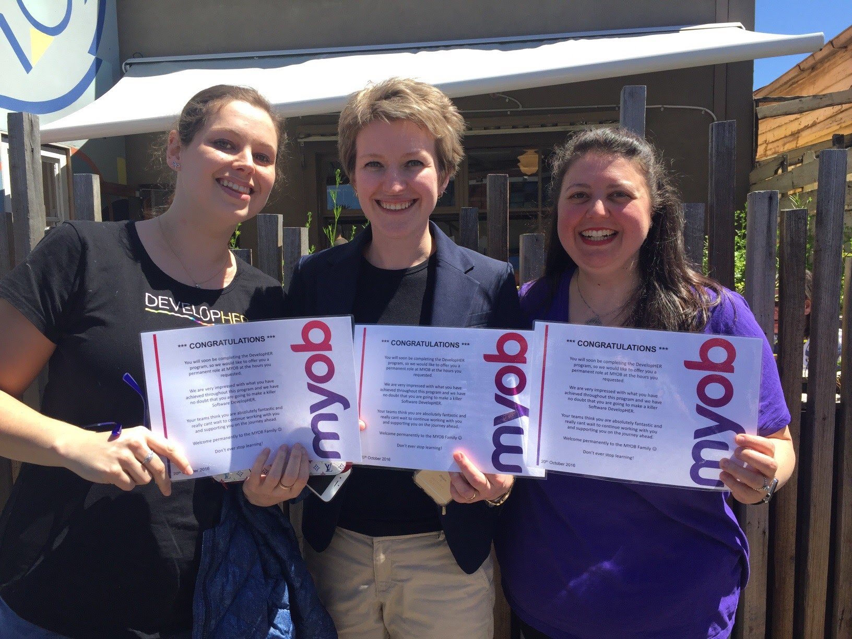
Graduate Developers
Description

Slide 17
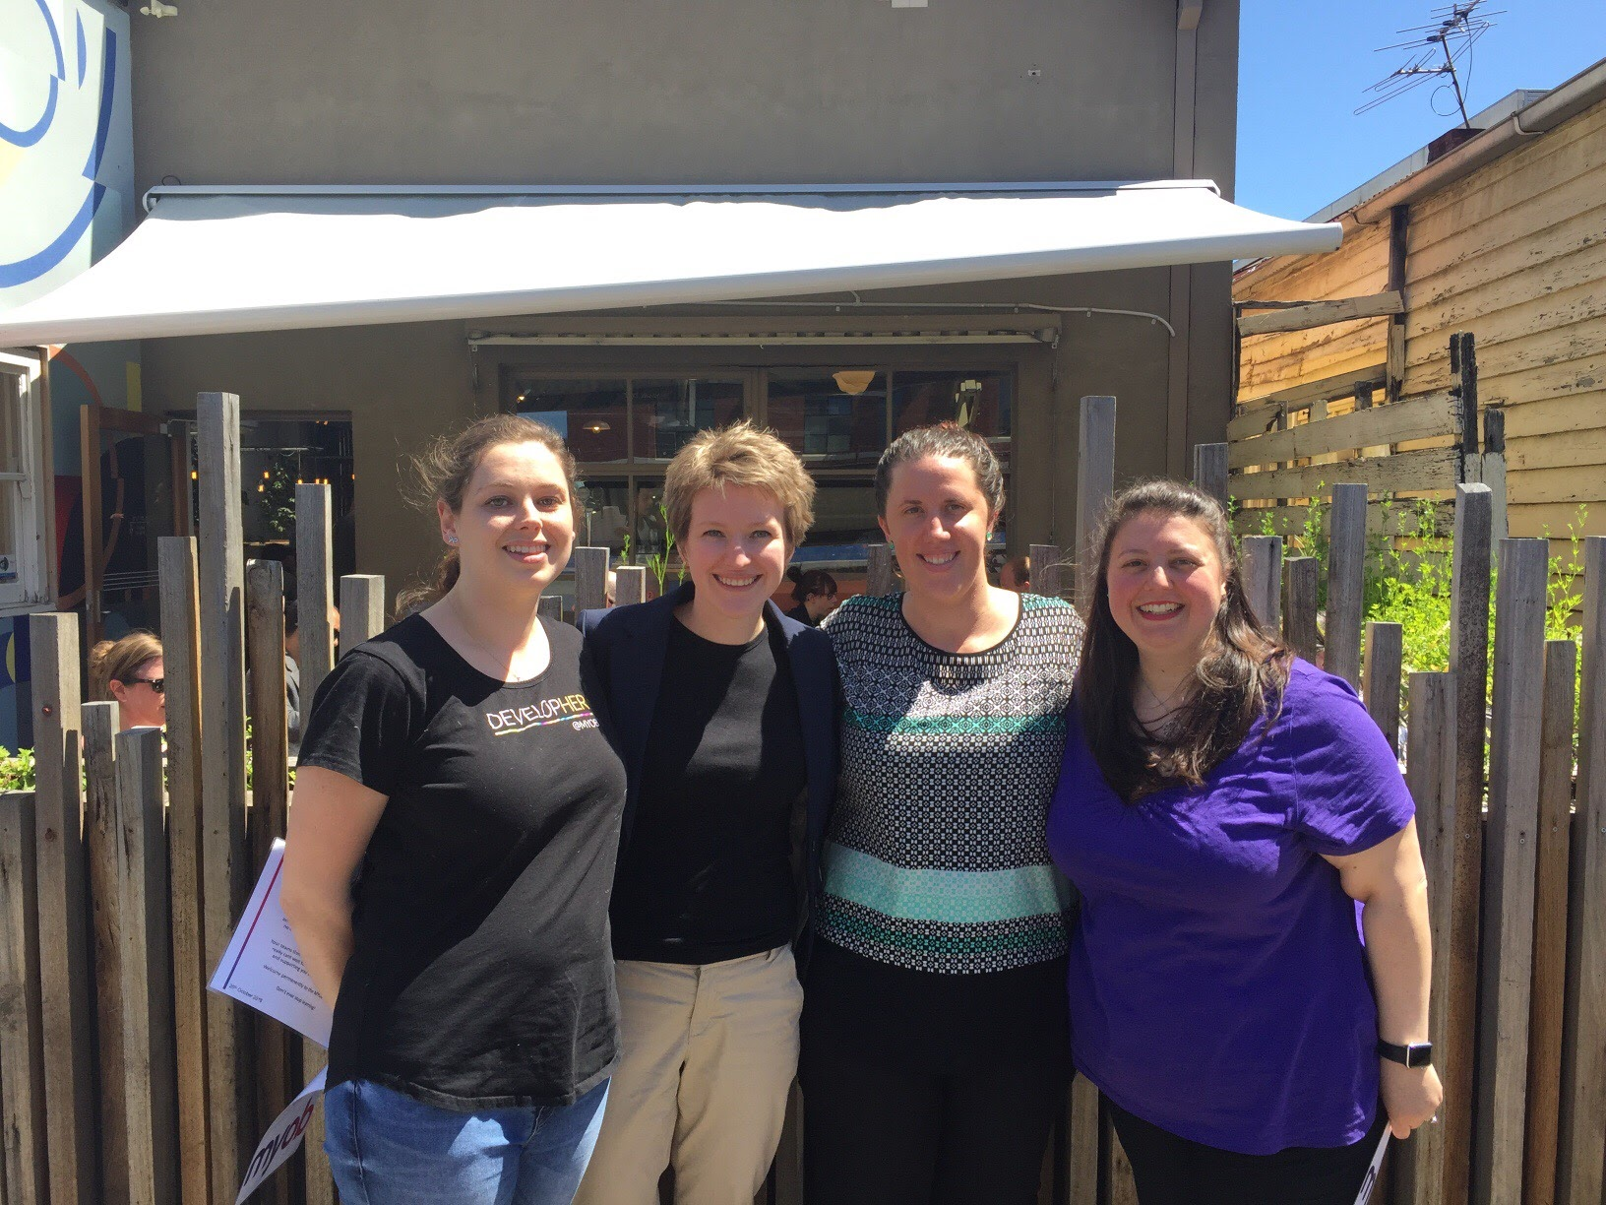
Contracts celebration
Description

Slide 18
Thank you
Tanya
John
Katherine
Simon
Andrew
Jonathan
Ognjen
Angela
Jeanie
Vivian
Mark
Dan
Michael
Clinton
Candice
Sally
Prash
…

